Slide 1
CONTENTS
Abstract
Existing system
Proposed system
Software and hardware requirements
Architecture diagram
Modules description
Data flow diagram
UML diagrams
Project Execution Screen Shots
Conclusion
References

Slide 2
ABSTRACT
Autism spectrum disorder (ASD) is the neuro development disorder. It effects on how the people communicate and interact with others. In this we particularly concerning three domains social functioning, communication and Stereotyped Behaviors. Diagnosis of autism requires significant amount of time and cost. ASD can be cause due to having an immediate family member who’s autistics, certain genetic mutations and some mental and physical health condition. Early detection of autism can come to a great help by prescribing patients with proper medication at an early stage. According to the ASD problem starts with childhood and continues to and keep going on into adolescence and adulthood. Based on some machine learning algorithms like Naive bayes, support vector machine, logistic regression, KNN, CNN (Convolution neural networking) for predicting and analysis of ASD problems in child, adolescents and Adults. So, this will try to shed light on characteristics and features of Autistic children and their common language, speech and communication related problems so that it may help to the diagnosis as soon as possible to take effective measures.

Slide 3
EXISTING SYSTEM
Initially this project has been developed by some research persons they developed machine learning models only.
They developed ml models like random forest algorithm and SVR. Those models have the less accuracy.

Slide 4
DRAWBACKS OF EXISTING SYSTEM
Patients are not aware of the disease. These model is not available to normal people.
These are just machine learning models, and these are not sufficient to predicts the diseases.
These models have the less accuracy. So, it comes under the lower fitting.

Slide 5
PROPOSED SYSTEM
We have collected the datasets from the Kaggle website and we pre-processed it
We are trying with so many algorithms like Random forest algorithm, decision tree, logistic regression, SVC and K-Neighbor Classifier and some methods like GridSearchCV and Pipeline too to increase the accuracy of research person model.
After adding these methods we are satisfied with accuracy which we got.
We are developing and hosting a website for the doctors and patients and general people which is available to all.

Slide 6
ADVANTAGES OF PROPOSED SYSTEM
Eco friendly and 24/7 available.
More accurate about the results.
We predicts the disease percentage and recommend the doctor's name and contact details for patient.

Slide 7
SOFTWARE RERUERIMENTS
Programming Languages:
Operating system :windows, ubuntu, mac
Technology :machine learning
Front end :HTML, javascript, css
Anaconda-jupyter Notebook

Slide 8
HARDWARE RERUERIMENTS
Processor: Minimum 1 GHz; Recommended 2GHz or more
Ethernet connection (LAN) OR a wireless adapter (Wi-Fi)
Hard Drive: Minimum 32 GB; Recommended 64 GB or more
Memory (RAM): Minimum 1 GB; Recommended 4 GB or above

Slide 9
ARCHITECTURE DIAGRAM
Getting access to webpage
Data Collection from Webpage
Preprocessing Data
Applying ML models
Displaying output on Webpage
Predict output with pickle file
Generate Pickle file

Slide 10
MODULE DESCRIPTION
MODULE 1:
Data Collection and training using Machine Learning
MODULE 2:
Real Time data gathering and prognostics GUI design
MODULE 3:
Applying machine learning algorithms

Slide 11
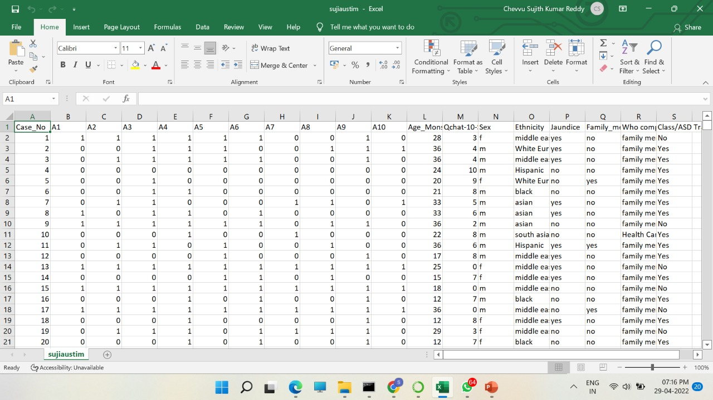
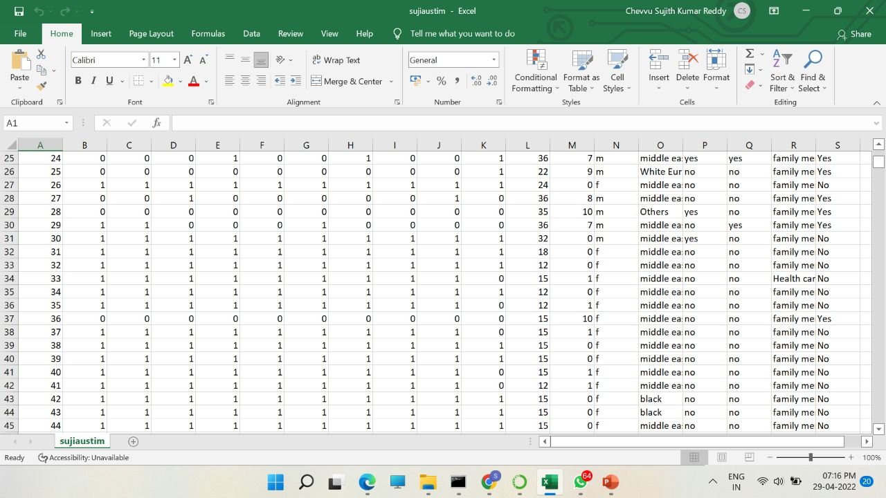
MODULE:1
1.1 Collection of data

Slide 12
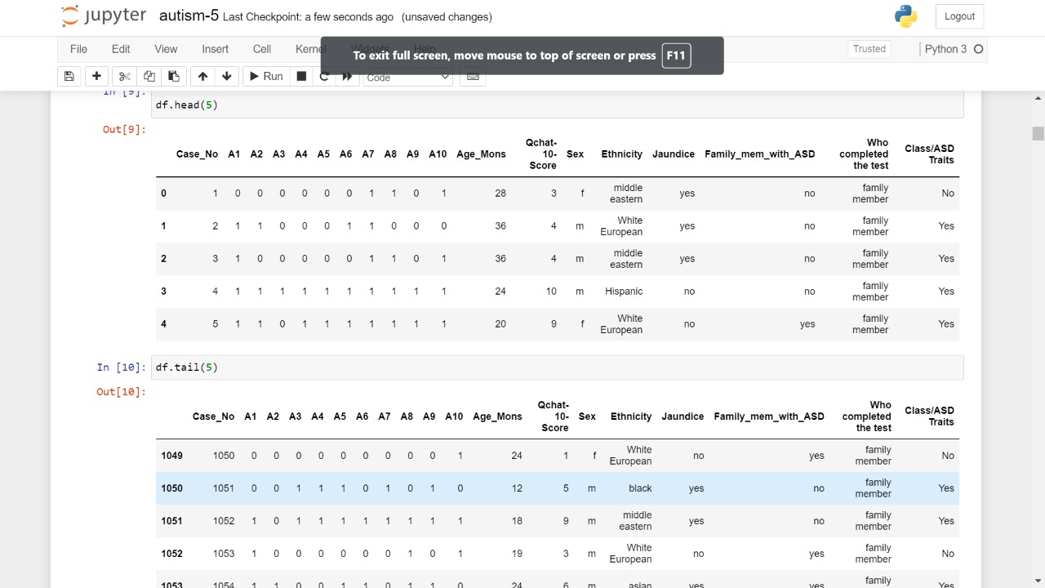
MODULE 1.2: Processing the data

Slide 13
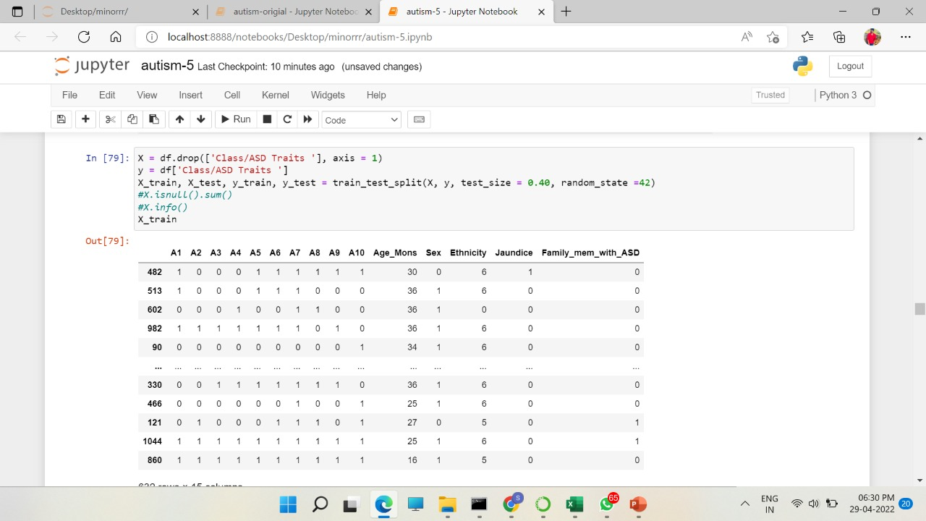
MODULE 1.3: Training the data

Slide 14
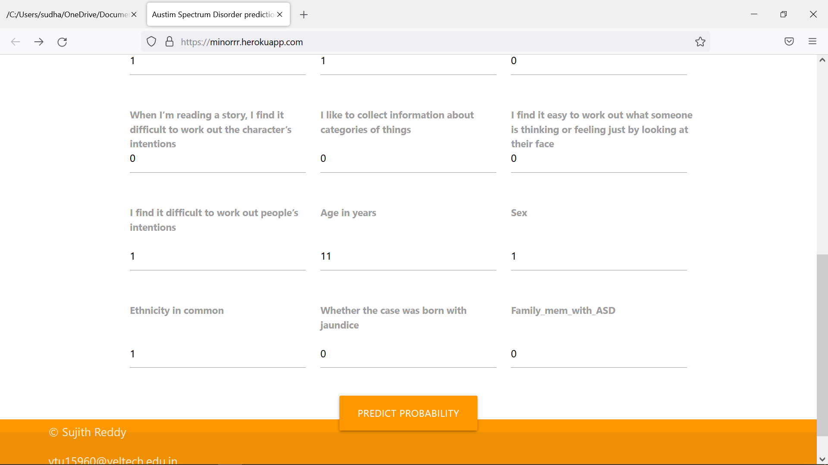
MODULE 2 :
Designing User Interface

Slide 15
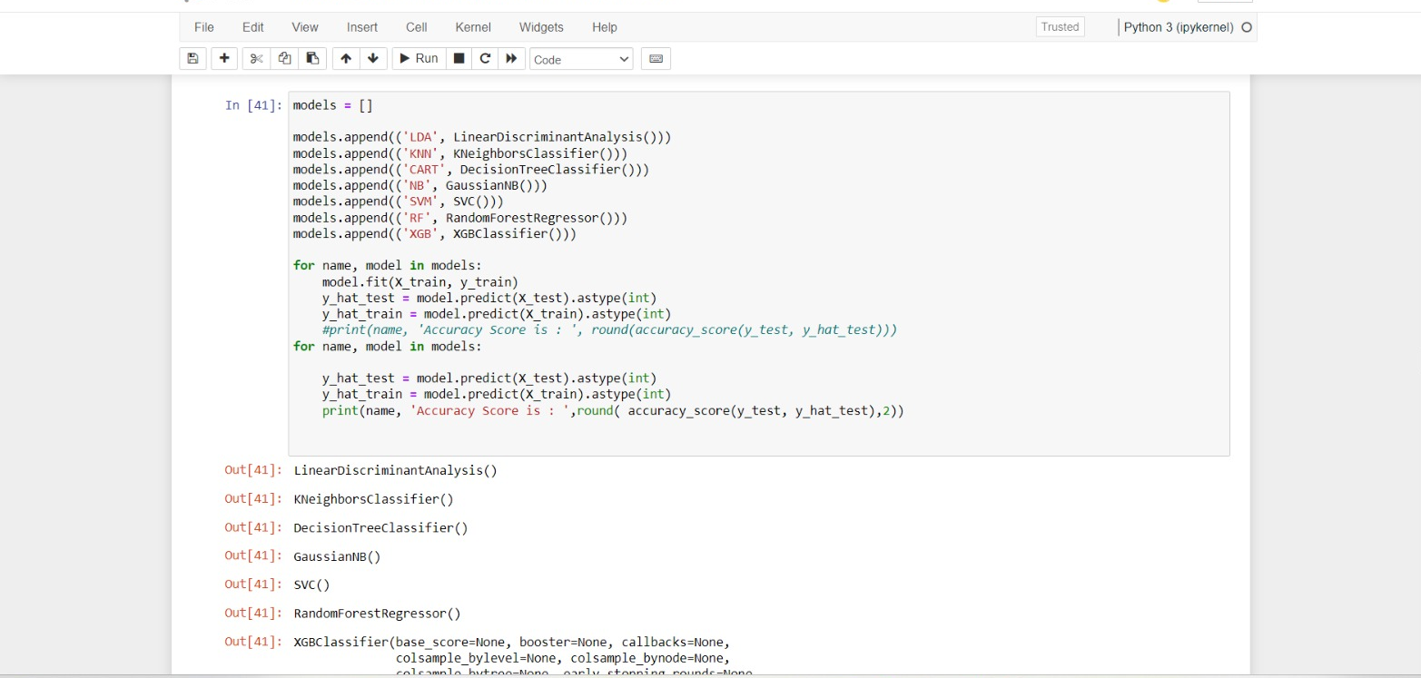
MODULE 3:
Applying Machine Learning Algorithms

Slide 16
DATA FLOW DIAGRAM:
Doctors
Login & Register
Upload the Data
Preprocessing and Analysis the Data
Sending Data to pickle
Patients
logout
Display on Webpage
Getting the Output
Getting the Output

Slide 17
5.UML DIAGRAMS
A3
A4
A5
A2
Family with ASD
ER DIAGRAM
A1
username
Jaundice
login
AUTISM MODEL
Password
login
SEX
username
AGE
password
register
A10
Phone Number
A6
A7
A8
A9
city

Slide 18
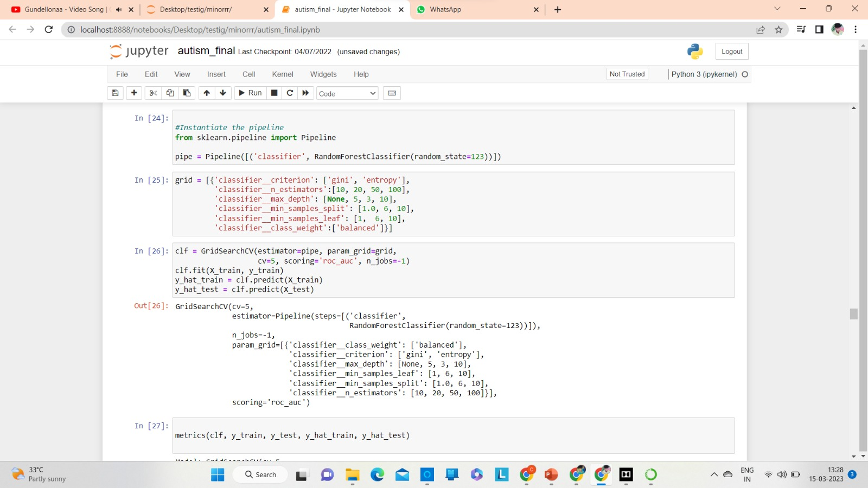
INCREASING ACCURACY USING GIRDSEARCH AND PIPELINE METHOD

Slide 19
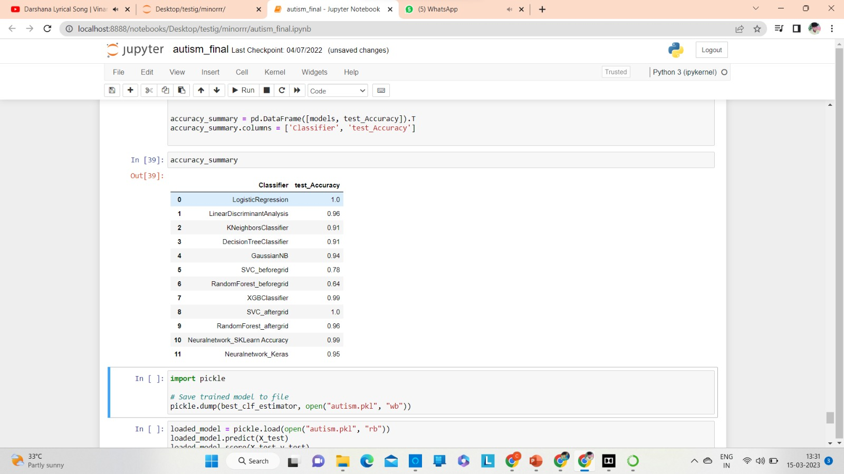
PROJECT EXECUTION AND SCREENSHOTS
You can see below the algorithms what we have mentioned accuracy percentage. Here we have clearly mentioned accuracy of algorithms before and after applying methods. Initially we have given priority for the algorithms which have moderate accuracy not the overfitting and underfittig.

Slide 20
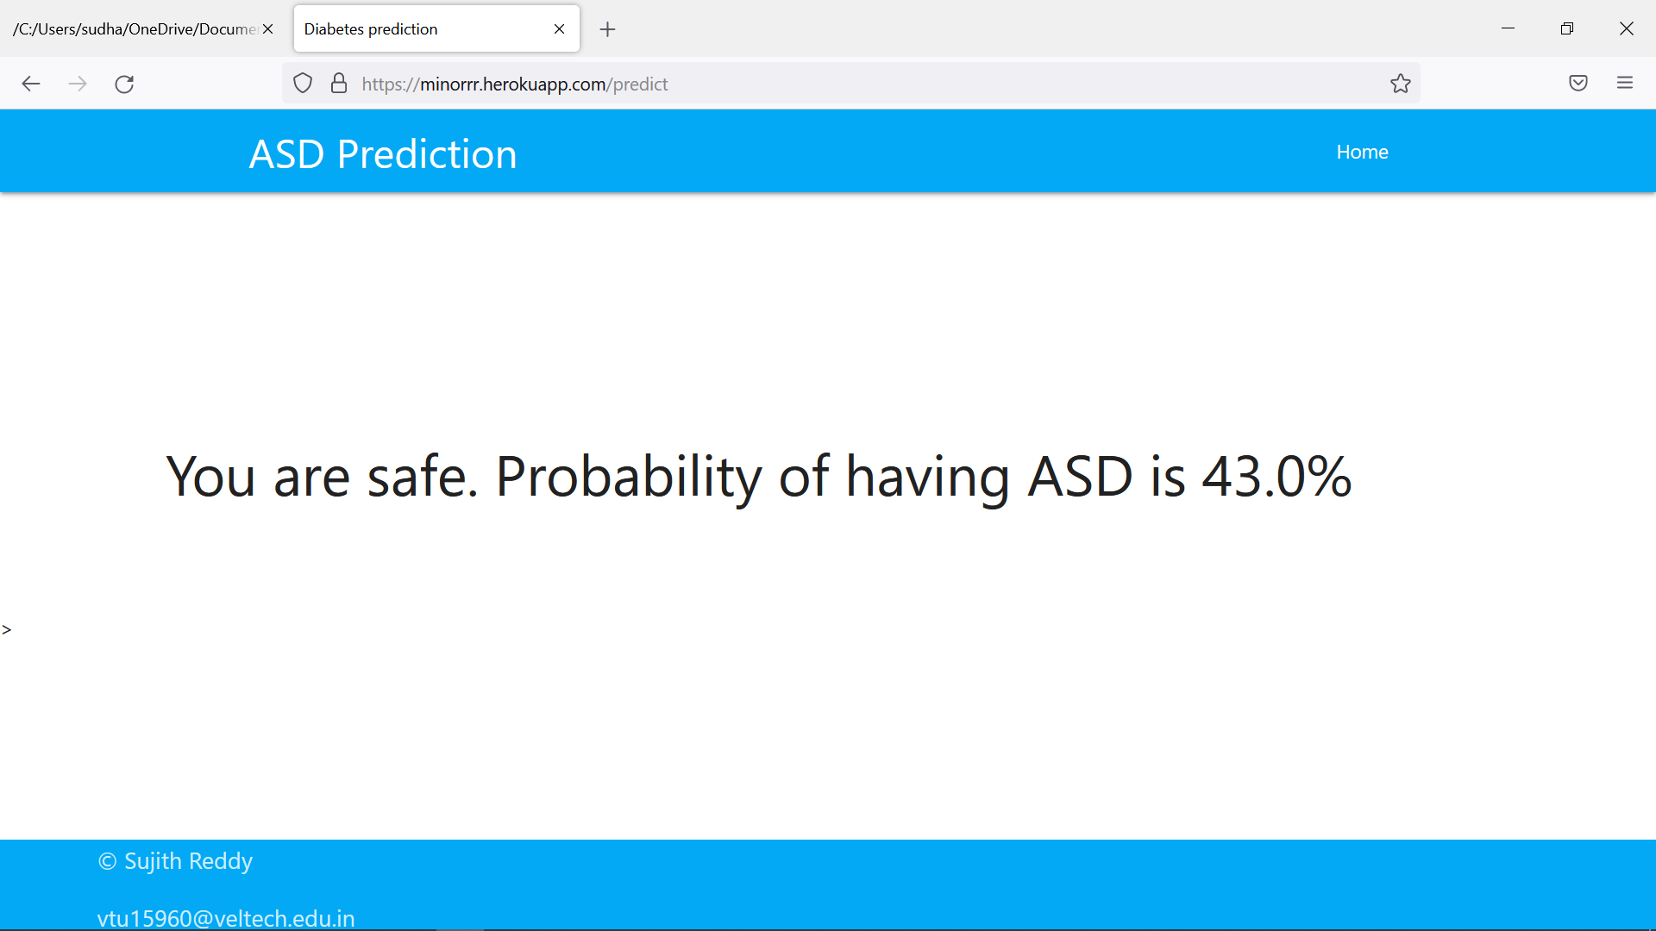
PROJECT EXECUTION AND SCREENSHOTS
PROJECT EXECUTION AND SCREENSHOTS

Slide 21
CONCLUSION:
In this work, detection of autism spectrum disorder was attempted using various machine learning and deep learning techniques. Various performance evaluation metrics were used to analyze the performance of the models implemented for ASD detection on non-clinical dataset from three sets of age groups viz. Child, Adolescents and the Adult. When comparing the result with another recent study These results strongly suggest that a Random Forest model can be implemented for detection of autism spectrum disorder in addition to enhance the prediction process that decide if the person has autism spectrum disorder or not and also showing the estimated percentage. Since we use same random forest algorithm we have increased the accuracy from 64 to 96 using GirdSearchCV and pipeline methods these are existing methods only we just applied according to our conditions.

Slide 22
REFERENCES(as per IEEE format only)
Autism Spectrum Disorder: Classification, diagnosis and therapy Samata R Sharma , Xenia Gonda ,Frank I Tarazi.
Harshini Manohar , Pooja Patnaik Kuppili , Preeti Kandasamy2019 march ,Implications of comorbid ADHD in ASD interventions and outcome: Results from a naturalistic follow up study from south India.
Ditza Antebi Zachor,2020 feb,This study evaluated the effectiveness of the ESDM for preschool-aged children with ASD using a predominantly group-based intervention in a community child care setting Ditza Antebi Zachor,2020 feb.
Myers SM. The status of pharmacotherapy for autism spectrum disorders. Expert Opin Pharmacother. 2007 Aug;
MMWR Surveill Summ. 2014 Mar 28,Developmental Disabilities Monitoring Network Surveillance Year Principal I. Prevalence of autism spectrum disorder among children aged 8 years - autism and developmental disabilities monitoring network, 11 sites, United States, 2010.
Fecteau S, Mottron L, Berthiaume C, et al. Developmental changes of autistic symptoms. Autism. 2003 Sep.
Shattuck PT, Seltzer MM, Greenberg JS, et al. Change in autism symptoms and maladaptive behaviors in adolescents and adults with an autism spectrum disorder. J Autism Dev Disord. 2007 Oct.
valsamma Eapen 2018 jan , The Behavioral interventions for children with autism spectrum disorders,the intervention behavioral is only treatment for young children with ASD s.

Slide 23


